Slide 1
KeyStone I & II Software Ecosystem Overview Multicore Processors

Slide 2
Agenda
Development Ecosystem
C66 MCSDK Perspective
ARM Linux Perspective
Drivers & Platform Software
Multicore Programming Models
Network & Communication Services
Instrumentation, Trace, & Fault Management
Getting Started (Demonstrations, Libraries)
Notes:
NEW

Slide 3
Development Ecosystem
Standard Linux Development Tools
(host or target-based)
Multicore Software Development Kit (MCSDK)
Eclipse IDE
Code Composer
StudioTM (CCS)
Third Party
Plug-Ins
Host Computer
Target Board/Simulator
Emulator
Notes:
Tools
CodeGen with OpenMP, OpenCL support
Emulator
Debugger
Simulator
Profiler / DVT
3rd party tools
Software
SYS/BIOS MCSDK, Linux MCSDK
Multicore Demonstration
6.x DSP SYS/BIOS, 2.6.3x Linux
Platform Abstraction
Basic Networking
Inter core communication
Libraries
Generic
DSPLIB ; IMGLIB; IQ Math;
Application Specific
Image, Voice, Fax, Medical
Application specific codecs
Audio, Video and Speech – Encoders, decoders, transcoders
WiMAX, LTE, others..

Slide 4
Code Composer Studio (CCS)
Standard Linux Development Tools
(host or target-based)
Multicore Software Development Kit (MCSDK)
Eclipse IDE
Code Composer
StudioTM (CCS)
Third Party
Plug-Ins
Host Computer
Target Board/Simulator
Emulator
Notes:
Tools
CodeGen with OpenMP, OpenCL support
Emulator
Debugger
Simulator
Profiler / DVT
3rd party tools
Software
SYS/BIOS MCSDK, Linux MCSDK
Multicore Demonstration
6.x DSP SYS/BIOS, 2.6.3x Linux
Platform Abstraction
Basic Networking
Inter core communication
Libraries
Generic
DSPLIB ; IMGLIB; IQ Math;
Application Specific
Image, Voice, Fax, Medical
Application specific codecs
Audio, Video and Speech – Encoders, decoders, transcoders
WiMAX, LTE, others..

Slide 5
Code Composer Studio (CCS) Overview
Code Composer Studio (CCS) is an Eclipse-based IDE that supports application development on multiple cores/devices:
GUI interface for SYS/BIOS, project-based system to build drivers and utilities for developer’s target platform.
Multiple perspectives (default and custom)
Advance debugging, monitoring, and profiling
Multiple configurations allow a single executable or multiple executables to be generated for the same project.
Editor
Integrated compiler tools
Support for OpenMP
Simulator
Debug/Emulation
Remote Debug
Instrumentation
Visualization

Slide 6
Third-Party CCS Plug-Ins
Standard Linux Development Tools
(host or target-based)
Multicore Software Development Kit (MCSDK)
Eclipse IDE
Code Composer
StudioTM (CCS)
Editor
CCS Debugger
Third Party
Plug-Ins
CodeGen OpenMP
Remote Debug
GDB
Analyzer Suite
Trident
Host Computer
Target Board/Simulator
Emulator
Notes:
Tools
CodeGen with OpenMP, OpenCL support
Emulator
Debugger
Simulator
Profiler / DVT
3rd party tools
Software
SYS/BIOS MCSDK, Linux MCSDK
Multicore Demonstration
6.x DSP SYS/BIOS, 2.6.3x Linux
Platform Abstraction
Basic Networking
Inter core communication
Libraries
Generic
DSPLIB ; IMGLIB; IQ Math;
Application Specific
Image, Voice, Fax, Medical
Application specific codecs
Audio, Video and Speech – Encoders, decoders, transcoders
WiMAX, LTE, others..

Slide 7
Third-Party Software Overview
Eclipse allows developers to integrate third-party software tools that provide additional multicore programming, profiling and analysis capabilities:
Poly-Platform from PolyCore http://polycoresoftware.com is a development framework consisting of tools and run-time software that provide a programming model for applications to scale from one to many cores.
Prism from CriticalBlue http://www.criticalblue.com provides multicore analysis and exploration tools to evaluate parallelization strategies of existing software applications.
Optima from ENEA http://www.enea.com includes overview and management tools for multicore systems, profiling tools showing resource usage, and debug tools that track execution of application and operating system events.
Diamond from 3L http://www.3l.com is a tool-suite and model that provides a highly automated development flow from concept through to applications running in multiprocessor hardware.

Slide 8
Multicore SW Development Kit (MCSDK)
Standard Linux Development Tools
(host or target-based)
Multicore Software Development Kit (MCSDK)
Eclipse IDE
Code Composer
StudioTM (CCS)
Third Party
Plug-Ins
Editor
CCS Debugger
PolyCore
CodeGen OpenMP
Remote Debug
ENEA
Optima
GDB
Analyzer Suite
3L
Trident
Critical
Blue
Host Computer
Target Board/Simulator
Emulator
Notes:
Tools
CodeGen with OpenMP, OpenCL support
Emulator
Debugger
Simulator
Profiler / DVT
3rd party tools
Software
SYS/BIOS MCSDK, Linux MCSDK
Multicore Demonstration
6.x DSP SYS/BIOS, 2.6.3x Linux
Platform Abstraction
Basic Networking
Inter core communication
Libraries
Generic
DSPLIB ; IMGLIB; IQ Math;
Application Specific
Image, Voice, Fax, Medical
Application specific codecs
Audio, Video and Speech – Encoders, decoders, transcoders
WiMAX, LTE, others..

Slide 9
MCSDK: Overview
Set of software building blocks to facilitate development of applications
DSP and ARM platform software, low-level drivers, high-level APIs and other utilities
Source and prebuilt libraries are included
Embedded OS: SYS/BIOS RTOS on DSP; Linux on ARM
Development OS: Windows and Linux PC support
Free to download with all components in one installer
Notes:
Enables faster time to market and is easy to use

Slide 10
MCSDK: Folder Contents for Keystone 1
/mcsdk
/pdk
/edma3
/bios
/dsplib
/imglib
/mathlib
/ipc
/ndk
REPLACE WITH SNAPSHOT OF KEYSTONE 1 FOLDER STRUCTURE, LIKE IN NEXT SLIDE
Notes:
REPLACE WITH SNAPSHOT OF KEYSTONE 1 FOLDER STRUCTURE

Slide 11
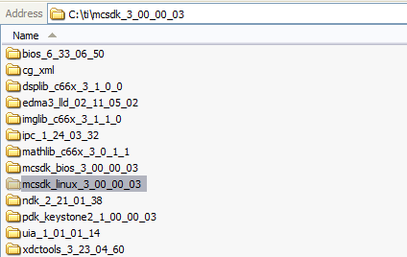
MCSDK: Folder Contents for Keystone 2

Slide 12
Agenda
Development Ecosystem
C66 MCSDK Perspective
ARM Linux Perspective
Drivers & Platform Software
Multicore Programming Models
Network & Communication Services
Instrumentation, Trace, & Fault Management
Getting Started (Demonstrations, Libraries)

Slide 13
MCSDK for Keystone 2
Out-of-Box Demonstration Applications and Examples
Software Framework Components
Communication Protocols
SYS/BIOS
RTOS
Interprocessor
Communication
Instrumentation
(MCSA)
TCP/IP
Networking
(NDK)
Algorithm Libraries
Platform/EVM Software
DSPLIB
IMGLIB
MATHLIB
Platform
Library
Transports - IPC - NDK
Low-Level Drivers (LLDs)
SA
RM
BCP
TCP3D
10GbE
Resource
Manager
POST
EDMA3
PA
SRIO
FFTC
TSIP
OSAL
Bootloader
PCIe
QMSS
CPPI
HyperLink
…
Chip Support Library
Hardware
Notes:
CSL support for low level configuration of PLL, PSC, DDR3, Interrupts, EDMA3 etc.
NIMU

Slide 14
Interface via LLD and CSL Layers

Slide 15
SYS/BIOS in KeyStone
Standard Linux Development Tools
(host or target-based)
Multicore Software Development Kit (MCSDK)
SMP Linux (ARM)
Out-of-Box
Demonstrations
SYS/BIOS
(DSP)
Optimized Libraries
Eclipse IDE
Multicore
Programming Models
Code Composer
StudioTM (CCS)
Third Party
Plug-Ins
Network & Communication Services
Editor
CCS Debugger
PolyCore
CodeGen OpenMP
Remote Debug
ENEA
Optima
GDB
Analyzer Suite
3L
Instrumentation & Trace
Fault Management
Library
Trident
Critical
Blue
Drivers and Platform Software
Host Computer
Target Board/Simulator
Emulator
Notes:
Tools
CodeGen with OpenMP, OpenCL support
Emulator
Debugger
Simulator
Profiler / DVT
3rd party tools
Software
SYS/BIOS MCSDK, Linux MCSDK
Multicore Demonstration
6.x DSP SYS/BIOS, 2.6.3x Linux
Platform Abstraction
Basic Networking
Inter core communication
Libraries
Generic
DSPLIB ; IMGLIB; IQ Math;
Application Specific
Image, Voice, Fax, Medical
Application specific codecs
Audio, Video and Speech – Encoders, decoders, transcoders
WiMAX, LTE, others..

Slide 16
SYS/BIOS
SYS/BIOS is a very efficient modular Real-time operating system developed for TI devices
Based on DSPBIOS that supported many generations of TI DSP
The name change to SYS/BIOS signified the fact that this operating system can run on other (non DSP) cores
A complete training presentation is dedicated to SYS/BIOS

Slide 17
Agenda
Development Ecosystem
C66 MCSDK Perspective
ARM Linux Perspective
Drivers & Platform Software
Multicore Programming Models
Network & Communication Services
Instrumentation, Trace, & Fault Management
Getting Started (Demonstrations, Libraries)

Slide 18
ARM Linux Perspective
Standard Linux Development Tools
(host or target-based)
Multicore Software Development Kit (MCSDK)
SMP Linux (ARM)
Out-of-Box
Demonstrations
SYS/BIOS
(DSP)
Optimized Libraries
Eclipse IDE
Multicore
Programming Models
Code Composer
StudioTM (CCS)
Third Party
Plug-Ins
Network & Communication Services
Editor
CCS Debugger
PolyCore
CodeGen OpenMP
Remote Debug
ENEA
Optima
GDB
Analyzer Suite
3L
Instrumentation & Trace
Fault Management
Library
Trident
Critical
Blue
Drivers and Platform Software
Host Computer
Target Board/Simulator
Emulator
Notes:
Tools
CodeGen with OpenMP, OpenCL support
Emulator
Debugger
Simulator
Profiler / DVT
3rd party tools
Software
SYS/BIOS MCSDK, Linux MCSDK
Multicore Demonstration
6.x DSP SYS/BIOS, 2.6.3x Linux
Platform Abstraction
Basic Networking
Inter core communication
Libraries
Generic
DSPLIB ; IMGLIB; IQ Math;
Application Specific
Image, Voice, Fax, Medical
Application specific codecs
Audio, Video and Speech – Encoders, decoders, transcoders
WiMAX, LTE, others..

Slide 19
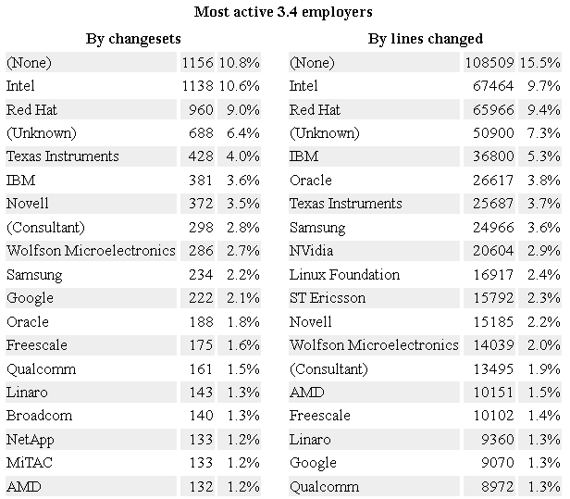



Linux Perspective: TI Open Source Presence
Active member of Linux Foundation
Founding member of Linaro
Sponsor of BeagleBoard and PandaBoard; top open hardware and open embedded software projects
Source http://lwn.net/Articles/496193/

Slide 20
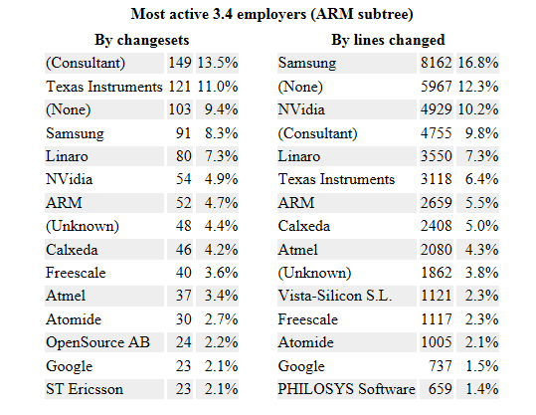
TI Open Source Presence For ARM
Source http://lwn.net/Articles/496193/

Slide 21
ARM Linux Perspective: Overview
Linux-based software platform for development, deployment, and execution of ARM A15 on KeyStone II.
Actively upstreaming Keystone II support to the open-source community
Source code and prebuilt images of u-boot and kernel
Open-source Linaro toolchain for compilation (gcc) and debug (gdb)
Load-and-run Linux kernel using Code Composer Studio
Telnet into device to view console print as device boots and to mount root filesystem
Notes:
21

Slide 22
ARM Linux Perspective: Overview
Development Tools
Build
ARM toolchain - Linaro
Optimized for Cortex-A15
GCC 4.6 based (4.7 in the works)
Debug
Code Composer Studio: Eclipse IDE, Linux aware debug, GDB Integration
On Target: GDB, Valgrind, and most standard Linux tools
Optimize
Code Composer Studio: Integrated profiling and trace tools
On Target: O-Profile, Gcov, Gprof, GDB Trace Points
Linux Platform Software
Boot
U-Boot(/SPL) Support
Boot Modes (SPI, NAND, …)
Network boot
Kernel
Linux 3.6+, to be upstreamed
Distribution
Arago:
Target Applications
Packet Processing
Datacenter/Enterprise
SMP Support, Full set of drivers
Community aligned, Unified kernel
6WINDGate
Multimedia/HPC
VDI
Video transcode
Many node cluster
Transport network data path applications
Data center and network appliances
Enterprise gateway
HPC DSP Accl. (linpack, multicore- FFT)
OpenEmbedded based
Yocto Aligned

Slide 23
ToolChain
Linaro (ARM)
Linaro releases optimized toolchains for recent ARM CPUs (Cortex A8, A9...). These include Linaro's latest contributions to mainline gcc, but backported to stable gcc versions for immediate use by product developers. Linaro actually hires CodeSourcery people to improve ARM toolchains, so the ARM toolchains that you get with Linaro should be at least as good as the CodeSourcery ones.
Native toolchains are available through the standard gcc toolchain in Ubuntu. Cross toolchains are available to Ubuntu users through special packages

Slide 24
Debug
GDB can do four main kinds of things (plus other things in support of these) to help you catch bugs in the act:
Start your program, specifying anything that might affect its behavior.
Make your program stop on specified conditions.
Examine what has happened, when your program has stopped.
Change things in your program, so you can experiment with correcting the effects of one bug and go on to learn about another.
I see Valgrind as a simulator
Valgrind is in essence a virtual machine using just-in-time (JIT) compilation techniques, including dynamic recompilation. Nothing from the original program ever gets run directly on the host processor. Instead, Valgrind first translates the program into a temporary, simpler form called Intermediate Representation (IR), which is a processor-neutral, SSA-based form. After the conversion, a tool (see below) is free to do whatever transformations it would like on the IR, before Valgrind translates the IR back into machine code and lets the host processor run it. Even though it could use dynamic translation (that is, the host and target processors are from different architectures), it doesn't. Valgrind recompiles binary code to run on host and target (or simulated) CPUs of the same architecture.

Slide 25
Optimization
OProfile - system-wide statistical profiling tool for Linux. Written by John Levon in 2001 for Linux kernel version 2.4 after his M.Sc. project.^{[1]} Consists of kernel module, user-space daemon and several user-space tools.
This tool is capable of profiling entire system or its parts, from interrupt routines or drivers, to user-space processes. It has low overhead.
Gcov is a source code coverage analysis and statement-by-statement profiling tool. Gcov generates exact counts of the number of times each statement in a program is executed and annotates source code to add instrumentation. Gcov comes as a standard utility with GNU CC (GCC) suite.^{[1]}
The gcov utility gives information on how often a program executes segments of code.^{[2]} It produces a copy of the source file, annotated with execution frequencies. The gcov utility does not produce any time-based data and works only on code compiled with GNU CC. It is not compatible with any other profiling or test coverage mechanism.[
gprof is a performance analyzing tool in Unix. It uses a hybrid of instrumentation and sampling ^{[1]} and is an extension of older "prof" Unix tool. Unlike prof, gprof is capable of limited call graph printing.[

Slide 26
U-Boot and SPL
U-Boot is a universal boot loader for embedded boards based on PowerPC, ARM, MIPS and several other processors, which can be installed in a boot ROM and used to initialize and test the hardware or to download and run OS and application code.
serial console support
integrated shell alike setup interface
optional password protectection and timeout for acces to setup interface on boot
editable configuration space
downloads software trough tftp servers
flash routines for EEPROMS of misc technology including NANDs
runs test applications directly
boots Linux
X-loader up-streaming(SPL) -
. The idea is to build a mini u-boot out of the u-boot tree that fits into SRAM and bootloads the real u-boot into the SDRAM.
The SPL support the following when up-streamed
Basic ARM initialization
UART console initialization
Clocks and DPLL locking (minimal)
SDRAM initialization
Mux (minimal)
MMC initialization(MMC1/MMC2 based on where we are booting from)
Bootloading real u-boot from MMC and passing control to it.

Slide 27
Linux SMP (Symmetric Multiprocessors)
Symmetric multiprocessing (SMP) involves a multiprocessor computer hardware architecture where two or more identical processors are connected to a single shared main memory and are controlled by a single OS instance. Most common multiprocessor systems today use an SMP architecture. In the case of multi-core processors, the SMP architecture applies to the cores, treating them as separate processors.
SMP systems are tightly coupled multiprocessor systems with a pool of homogeneous processors running independently, each processor executing different programs and working on different data and with capability of sharing common resources (memory, I/O device, interrupt system and so on) and connected using a system bus or a crossbar.

Slide 28
Distribution
Yocto
The Yocto Project™ is an open source collaboration project that provides templates, tools and methods to help you create custom Linux-based systems for embedded products regardless of the hardware architecture. The Yocto Project includes core system component recipes provided by the OpenEmbedded project. Community-tested images include the Yocto Project kernel and cover four build profiles (minimal, sato, sdk and LSB) across multiple architectures including ARM, PPC, MIPS, x86 and x86-64. Specific platform support takes the form of Board Support Package (BSP) layers for which a standard format has been developed.
Arago
Arago Project is an open integration, build, and test infrastructure that provides a portal into how Texas Instruments creates customer ready Linux SDKs for their media processors.
Arago Project is an overlay for OpenEmbedded, which targets TI platforms OMAP (EVM and BeagleBoard) DaVinci and KeyStone and provides a verified, tested and supported subset of packages.

Slide 29
Applications
6WINDGate™ is the only commercial software solution that solves critical network performance challenges for OEMs delivering advanced networking functions in SDN markets such as mobile infrastructure, network appliances and data center networking
Virtual desktop infrastructure (VDI) is the practice of hosting a desktop operating system within a virtual machine (VM) running on a centralized server. VDI is a variation on the client/server computing model, sometimes referred to as server-based computing. The term was coined by VMware Inc.
Data Center
High-density, multicore server hardware
• Virtualization of servers and storage
• High-bandwidth networks
• Scalable cloud computing architectures
• Network convergence
• Ethernet fabrics

Slide 30
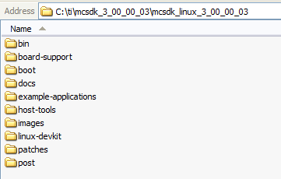
ARM Linux Perspective: Folder Contents
Notes:
30

Slide 31
Agenda
Development Ecosystem
C66 MCSDK Perspective
ARM Linux Perspective
Drivers & Platform Software
Multicore Programming Models
Network & Communication Services
Instrumentation, Trace, & Fault Management
Getting Started (Demonstrations, Libraries)

Slide 32
Drivers & Platform Software
Standard Linux Development Tools
(host or target-based)
Multicore Software Development Kit (MCSDK)
SMP Linux (ARM)
Out-of-Box
Demonstrations
SYS/BIOS
(DSP)
GDB
oprofile
Optimized Libraries
gcc
gprof
Eclipse IDE
Multicore
Programming Models
Code Composer
StudioTM (CCS)
Third Party
Plug-Ins
Network & Communication Services
Editor
CCS Debugger
PolyCore
CodeGen OpenMP
Remote Debug
ENEA
Optima
GDB
Analyzer Suite
3L
Instrumentation & Trace
Fault Management
Library
Trident
Critical
Blue
Drivers and Platform Software
Host Computer
Target Board/Simulator
Emulator
Notes:
Tools
CodeGen with OpenMP, OpenCL support
Emulator
Debugger
Simulator
Profiler / DVT
3rd party tools
Software
SYS/BIOS MCSDK, Linux MCSDK
Multicore Demonstration
6.x DSP SYS/BIOS, 2.6.3x Linux
Platform Abstraction
Basic Networking
Inter core communication
Libraries
Generic
DSPLIB ; IMGLIB; IQ Math;
Application Specific
Image, Voice, Fax, Medical
Application specific codecs
Audio, Video and Speech – Encoders, decoders, transcoders
WiMAX, LTE, others..

Slide 33
Drivers & Platform Software: DSP
CPPI
Hyperlink
PA (Packet Accelerator)
SA (Security Accelerator)
PCIe
QMSS
RM (Resource Management)
SRIO
TSIP
NIMU
EDMA3
CSL support for PLL, PSC, DDR3, Interrupts, and others

Slide 34
Drivers & Platform Software: ARM
Peripherals:
Multicore Navigator, SRIO, SPI, UART, USB 3.0, I2C with EEPROM, GPIO, EMIF16 – NAND Flash, PLL & PSC, Ethernet subsystem - 1G Switch and NetCP
Semaphore:
Using Linux hardware spinlock
Interrupt Configuration:
Generic Interrupt Controller (GIC) using Linux IRQ API for ARM
External Memory:
LPAE support for DDR3A to access more than 2GB of DDR3A
Booting via both DDR3A and DDR3B supported
Debug and Trace:
Performance Monitoring Unit (PMU) and oprofile support
Notes:
LPAE - Large Physical Address Extension

Slide 35
Drivers & Platform Software: Summary
Module | DSP (CSL) | DSP (LLD) | ARM (CSL) | ARM (User Mode LLD) | ARM (Linux kernel)
Timer64 | x |  | x
ARM Arch Timer |  |  |  |  | x
ARM Intc (GIC) |  |  | x |  | x
CPINTC | x |  | x
CPSW (5-port 10G) | x |  | x |  | x
USB 3.0 | x |  | x |  | x
GPIO | x |  | x |  | x
EMIF16 - NAND | x |  | x |  | x
I2C | x |  | x |  | x
USIM | x |  | x |  | x
UART | x |  | x |  | x
SPI | x |  | x |  | x
AIF2 | x | x
SRIO | x | x | x |  | x
PCIe | x | x | x |  | x
PA | x | x | x | x | x
SA | x | x | x | x | x
CPSW (5-port 1G) | x |  | x |  | x
QMSS + PktDMA | x | x | x | x | x
RAC | x
TAC2 | x
VCP2 | x
TCP3D | x | x
BCP | x | x
FFTC | x | x
EDMA | x | x
HyperLink | x | x | x | x
HW Semaphore | x |  |  |  | x
PSC |  |  |  |  | x

Slide 36
Agenda
Development Ecosystem
C66 MCSDK Perspective
ARM Linux Perspective
Drivers & Platform Software
Multicore Programming Models
Network & Communication Services
Instrumentation, Trace, & Fault Management
Getting Started (Demonstrations, Libraries)

Slide 37
Multicore Programming Models
Standard Linux Development Tools
(host or target-based)
Multicore Software Development Kit (MCSDK)
SMP Linux (ARM)
Out-of-Box
Demonstrations
SYS/BIOS
(DSP)
GDB
oprofile
Optimized Libraries
gcc
gprof
Eclipse IDE
Multicore
Programming Models
Code Composer
StudioTM (CCS)
Third Party
Plug-Ins
Network & Communication Services
Editor
CCS Debugger
PolyCore
CodeGen OpenMP
Remote Debug
ENEA
Optima
GDB
Analyzer Suite
3L
Instrumentation & Trace
Fault Management
Library
Trident
Critical
Blue
Drivers and Platform Software
Host Computer
Target Board/Simulator
Emulator
Notes:
Tools
CodeGen with OpenMP, OpenCL support
Emulator
Debugger
Simulator
Profiler / DVT
3rd party tools
Software
SYS/BIOS MCSDK, Linux MCSDK
Multicore Demonstration
6.x DSP SYS/BIOS, 2.6.3x Linux
Platform Abstraction
Basic Networking
Inter core communication
Libraries
Generic
DSPLIB ; IMGLIB; IQ Math;
Application Specific
Image, Voice, Fax, Medical
Application specific codecs
Audio, Video and Speech – Encoders, decoders, transcoders
WiMAX, LTE, others..

Slide 38
Multicore Programming Models
OpenMP is an API for writing multi-threaded applications:
Includes compiler directives and library routines
C, C++, and Fortran support
OpenEM is a centralized runtime system that schedules events across all resources of the system in an optimized and dynamic way.
Open source (BSD license)
http://sourceforge.net/projects/eventmachine
Standard API and reference implementation
Notes:
DSP out file loaded with ARM – and ARM-DSP communication via MultiProc module running on ARM side

Slide 39
Agenda
Development Ecosystem
C66 MCSDK Perspective
ARM Linux Perspective
Drivers & Platform Software
Multicore Programming Models
Network & Communication Services
Instrumentation, Trace, & Fault Management
Getting Started (Demonstrations, Libraries)

Slide 40
Network & Communication Services
Standard Linux Development Tools
(host or target-based)
Multicore Software Development Kit (MCSDK)
SMP Linux (ARM)
Out-of-Box
Demonstrations
SYS/BIOS
(DSP)
GDB
oprofile
Optimized Libraries
gcc
gprof
Eclipse IDE
Multicore
Programming Models
Code Composer
StudioTM (CCS)
Third Party
Plug-Ins
Network & Communication Services
Editor
CCS Debugger
PolyCore
CodeGen OpenMP
Remote Debug
ENEA
Optima
GDB
Analyzer Suite
3L
Instrumentation & Trace
Fault Management
Library
Trident
Critical
Blue
Drivers and Platform Software
Host Computer
Target Board/Simulator
Emulator
Notes:
Tools
CodeGen with OpenMP, OpenCL support
Emulator
Debugger
Simulator
Profiler / DVT
3rd party tools
Software
SYS/BIOS MCSDK, Linux MCSDK
Multicore Demonstration
6.x DSP SYS/BIOS, 2.6.3x Linux
Platform Abstraction
Basic Networking
Inter core communication
Libraries
Generic
DSPLIB ; IMGLIB; IQ Math;
Application Specific
Image, Voice, Fax, Medical
Application specific codecs
Audio, Video and Speech – Encoders, decoders, transcoders
WiMAX, LTE, others..

Slide 41
Communication Services
IPC – Inter-Processor Communication APIs
MultiProc Module
Configure number of processors in SoC
ARM-DSP communication interface
Example included in MCSDK
IPC Transports | Task-to-Task | Core-to-Core | Device-to-Device
Shared Memory | x | x
Navigator/QMSS | x | x
SRIO |  |  | x
Notes:
DSP out file loaded with ARM – and ARM-DSP communication via MultiProc module running on ARM side

Slide 42
Network Services
Network Development Kit (NDK) serves as a rapid prototype platform for the development of network and packet-processing applications.
IPv6 and IPv4 compliant TCP/IP stack
Layer 3 & 4 network protocols
High-level network applications including HTTP server and DHCP
For more information, refer to the NDK User’s Guide http://www-s.ti.com/sc/techlit/spru523.pdf
Notes:
DSP out file loaded with ARM – and ARM-DSP communication via MultiProc module running on ARM side

Slide 43
Agenda
Development Ecosystem
C66 MCSDK Perspective
ARM Linux Perspective
Drivers & Platform Software
Multicore Programming Models
Network & Communication Services
Instrumentation, Trace, & Fault Management
Getting Started (Demonstrations, Libraries)

Slide 44
Instrumentation, Trace, & Fault Mgmt
Standard Linux Development Tools
(host or target-based)
Multicore Software Development Kit (MCSDK)
SMP Linux (ARM)
Out-of-Box
Demonstrations
SYS/BIOS
(DSP)
GDB
oprofile
Optimized Libraries
gcc
gprof
Eclipse IDE
Multicore
Programming Models
Code Composer
StudioTM (CCS)
Third Party
Plug-Ins
Network & Communication Services
Editor
CCS Debugger
PolyCore
CodeGen OpenMP
Remote Debug
ENEA
Optima
GDB
Analyzer Suite
3L
Instrumentation & Trace
Fault Management
Library
Trident
Critical
Blue
Drivers and Platform Software
Host Computer
Target Board/Simulator
Emulator
Notes:
Tools
CodeGen with OpenMP, OpenCL support
Emulator
Debugger
Simulator
Profiler / DVT
3rd party tools
Software
SYS/BIOS MCSDK, Linux MCSDK
Multicore Demonstration
6.x DSP SYS/BIOS, 2.6.3x Linux
Platform Abstraction
Basic Networking
Inter core communication
Libraries
Generic
DSPLIB ; IMGLIB; IQ Math;
Application Specific
Image, Voice, Fax, Medical
Application specific codecs
Audio, Video and Speech – Encoders, decoders, transcoders
WiMAX, LTE, others..

Slide 45
Instrumentation, Trace, & Fault Mgmt
DebugTools Library
Core trace:
Provides program counter and instruction timing
Core memory accesses and core events for DSP
System Trace:
Multicore application instrumentation (printf logging and binary data)
Core visibility (PC, data, timing trace), and processing relative to system
Correlate between traces - Processor, IP, EDMA
Library demonstrates SoC capabilities for multiple use-cases
TraceFramework Infrastructure
Multicore System Analyzer used as real-time tool to analyze, visualize and profile application performance and behavior on single or multiple cores
UIA provides messaging infrastructure that allows instrumentation clients to interact with instrumentation endpoints on a target device at run-time
Enables DSP/ARM applications to produce and consume information via ring buffers (single producer and multiple consumers are supported)
Fault Management Library
Enables application to store DSP register data upon fault detection

Slide 46
Agenda
Development Ecosystem
C66 MCSDK Perspective
ARM Linux Perspective
Drivers & Platform Software
Multicore Programming Models
Network & Communication Services
Instrumentation, Trace, & Fault Management
Getting Started (Demonstrations, Libraries)

Slide 47
Getting Started
Standard Linux Development Tools
(host or target-based)
Multicore Software Development Kit (MCSDK)
SMP Linux (ARM)
Out-of-Box
Demonstrations
SYS/BIOS
(DSP)
GDB
oprofile
Optimized Libraries
gcc
gprof
Eclipse IDE
Multicore
Programming Models
Code Composer
StudioTM (CCS)
Third Party
Plug-Ins
Network & Communication Services
Editor
CCS Debugger
PolyCore
CodeGen OpenMP
Remote Debug
ENEA
Optima
GDB
Analyzer Suite
3L
Instrumentation & Trace
Fault Management
Library
Trident
Critical
Blue
Drivers and Platform Software
Host Computer
Target Board/Simulator
Emulator
Notes:
Tools
CodeGen with OpenMP, OpenCL support
Emulator
Debugger
Simulator
Profiler / DVT
3rd party tools
Software
SYS/BIOS MCSDK, Linux MCSDK
Multicore Demonstration
6.x DSP SYS/BIOS, 2.6.3x Linux
Platform Abstraction
Basic Networking
Inter core communication
Libraries
Generic
DSPLIB ; IMGLIB; IQ Math;
Application Specific
Image, Voice, Fax, Medical
Application specific codecs
Audio, Video and Speech – Encoders, decoders, transcoders
WiMAX, LTE, others..

Slide 48
Getting Started: Development Flow
TI Demo Application on TI Evaluation Platform
TI Demo Application on Customer Platform
Customer Application on Customer Platform
Customer App on Next Generation TI SOC Platform
Demo Application
Demo Application
Customer Application
Customer Application
Tools
(UIA)
EDMA, Etc
Tools
(UIA)
EDMA, Etc
Tools
(UIA)
EDMA, Etc
Tools
(UIA)
EDMA, Etc
Network
Dev Kit
Network
Dev Kit
Network
Dev Kit
Network
Dev Kit
LLD
IPC
TI Platform
LLD
IPC
Customer Platform
LLD
IPC
Customer Platform
LLD
IPC
Next Gen TI Platform
CSL
CSL
CSL
CSL
No modifications required
Software may be different, but API remain the same (CSL, LLD, etc.)
May be used “as is” or customer can implement value-add modifications
Needs to be modified or replaced with customer version

Slide 49
Getting Started: Algorithm Libraries
Algorithm libraries contain C66x C-callable, hand-coded, assembly-optimized functions for specific usage:
Fundamental Math & Signal Processing Libraries
DSPLIB: Signal-processing math and vector functions
MathLIB: Floating-point math functions
Image & Video Processing Libraries
IMGLIB: Image/video processing functions
VLIB: Video analytics and vision functions
Telecommunication Libraries
VoLIB: Voice over IP application related functions
FaxLIB: FAX application related functions
Medical Libraries
STK-MED: Ultrasound and optical coherence tomography algorithms
More info: http://processors.wiki.ti.com/index.php/Software_libraries

Slide 50
Getting Started: Out-of-Box Demos
Keystone 1 & 2 demos:
Utility Application Demo
Known as HUA demo
Provides system information (OS version, CPU info, network interfaces), System statistics (mem/cpu usage, TX/RX pkts), Flash NAND/EEPROM, etc.
Image Processing Demo
Image edge detection demo
Keystone 2 demos:
IPC Demo
Load DSP out file from ARM and perform ARM-DSP communication
Transport Net Demo
NetCP capabilities including PA, SA and Ethernet Switch Subsystem
Notes:
50
In case of Keystone 2, there will be a GUI-based Matrix application launcher

Slide 51
KeyStone 1 EVM (TMDXEVM6678) Linux/BIOS MCSDK Details
DVD Contents
EVM Flash Contents
Factory default recovery
EEPROM: POST, IBL
NOR: BIOS MCSDK Demo
NAND: Linux MCSDK Demo
EEPROM/Flash writers
CCS 5.0
IDE
C667x EVM GEL/XML files
BIOS MCSDK 2.0
Source/binary packages
Linux MCSDK 2.0
Source/binary packages
EEPROM
128 KB
NOR
16 MB
NAND
64 MB
POST
BIOS MCSDK
“Out of Box” Demo
Linux MCSDK
Demo
IBL
Online Collateral
TMS320C667x processor website http://focus.ti.com/docs/prod/folders/print/tms320c6678.html http://focus.ti.com/docs/prod/folders/print/tms320c6670.html
MCSDK website for updates http://focus.ti.com/docs/toolsw/folders/print/bioslinuxmcsdk.html
CCS v5 http://processors.wiki.ti.com/index.php/Category:Code_Composer_Studio_v5
Developer’s website Linux: http://linux-c6x.org/
BIOS: http://processors.wiki.ti.com/index.php/BIOS_MCSDK_2.0_User_Guide
Notes:
51

Slide 52
Keystone 1 Development Tool Availability
Keystone 1 Evaluation Modules: Available
http://www.ti.com/tool/tmdxevm6678
http://www.ti.com/tool/tmdxevm6670
http://www.ti.com/tool/tmdxevm6657
MCSDK 2.1: Available
http://www.ti.com/tool/bioslinuxmcsdk
Toolchain: Available
https://www-a.ti.com/downloads/sds_support/TICodegenerationTools/download.htm
Internal Use Only
Notes:
52

Slide 53
Keystone 2 Development Tool Availability
Keystone 2 Evaluation Modules: End of 1Q-2013
MCSDK 3.0: Following EVM Release
Toolchain: Now
Linaro GCC4.6 toolchain Version 12.03
https://launchpad.net/linaro-toolchain-binaries/trunk/2012.03
Linux:
Uboot: Under development
Kernel: git://git.kernel.org/pub/scm/linux/kernel/git/torvalds/linux.git
Yocto distribution: git://arago-project.org/git/projects/oe-layersetup.git
Internal Use Only
Notes:
53

Slide 54
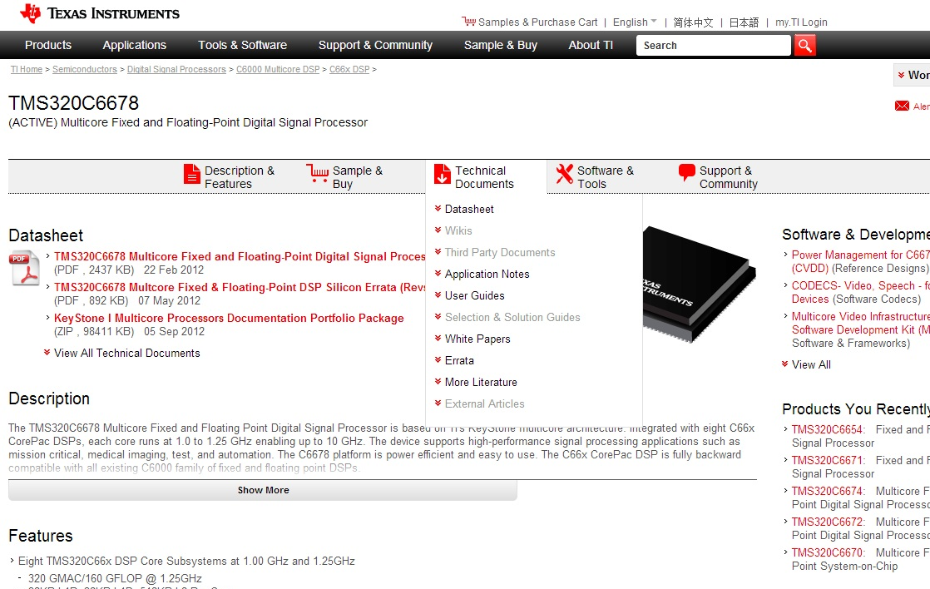
Online Collateral: Product Folders
http://www.ti.com/product/tms320c6678

Slide 55
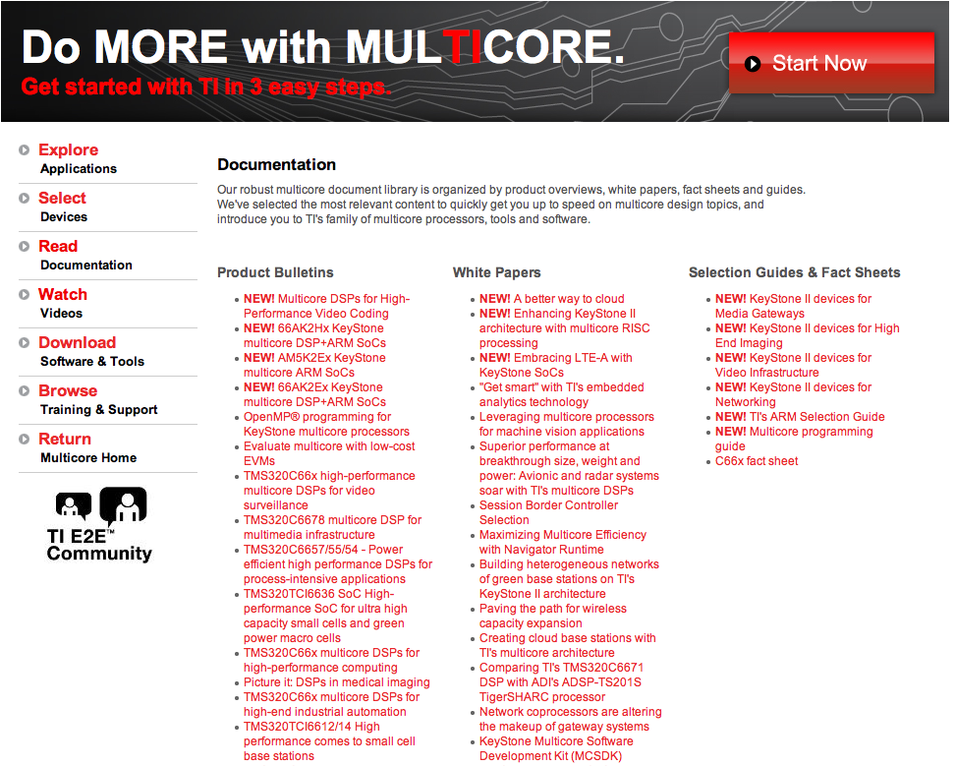
Online Collateral: Multicore Web
http://www.ti.com/multicore

Slide 56
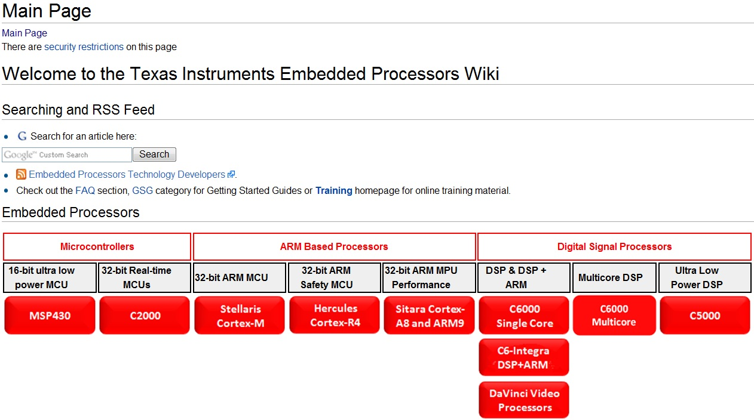
Online Collateral: EP Wiki
http://processors.wiki.ti.com

Slide 57
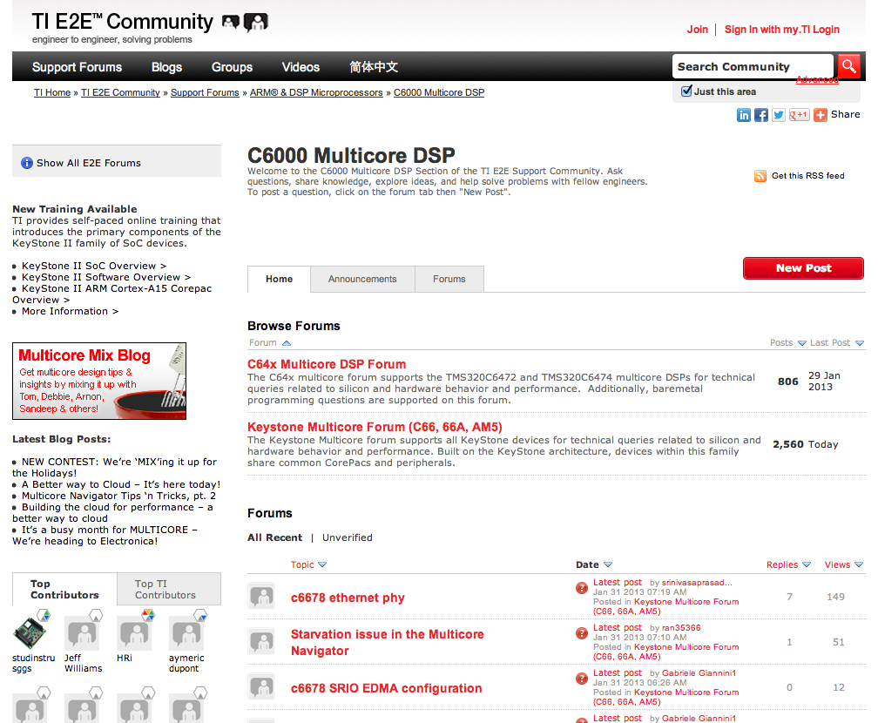
Online Support: E2E Forum
http://e2e.ti.com

Slide 58
Software Development Ecosystem
Standard Linux Development Tools
(host or target-based)
Multicore Software Development Kit (MCSDK)
SMP Linux (ARM)
Out-of-Box
Demonstrations
SYS/BIOS
(DSP)
GDB
oprofile
Optimized Libraries
gcc
gprof
Eclipse IDE
Multicore
Programming Models
Code Composer
StudioTM (CCS)
Third Party
Plug-Ins
Network & Communication Services
Editor
CCS Debugger
PolyCore
CodeGen OpenMP
Remote Debug
ENEA
Optima
GDB
Analyzer Suite
3L
Instrumentation & Trace
Fault Management
Library
Trident
Critical
Blue
Drivers and Platform Software
Host Computer
Target Board/Simulator
Emulator
Notes:
Tools
CodeGen with OpenMP, OpenCL support
Emulator
Debugger
Simulator
Profiler / DVT
3rd party tools
Software
SYS/BIOS MCSDK, Linux MCSDK
Multicore Demonstration
6.x DSP SYS/BIOS, 2.6.3x Linux
Platform Abstraction
Basic Networking
Inter core communication
Libraries
Generic
DSPLIB ; IMGLIB; IQ Math;
Application Specific
Image, Voice, Fax, Medical
Application specific codecs
Audio, Video and Speech – Encoders, decoders, transcoders
WiMAX, LTE, others..

Slide 59
Summary
Faster time to market for end-customer products
Stable foundation of optimized software components
Multicore programming methodologies
Free, full source code
Easy-to-use, hardened API
Modular software architecture to simplify migration to future SOC
Built-in demonstrations showcasing SoC strengths and multicore software framework
Positive customer out-of-box experience
Software ecosystem with third-party tools
Documentation: Online wiki
Support: E2E forum

Slide 60
For More Information
Software downloads and device-specific Data Manuals for the KeyStone II SoCs can be found at TI.com/multicore.
For articles related to multicore software and tools, refer to the Embedded Processors Wiki for the KeyStone Device Architecture.
For questions regarding topics covered in this training, visit the support forums at the TI E2E Community website.

